Slide 1

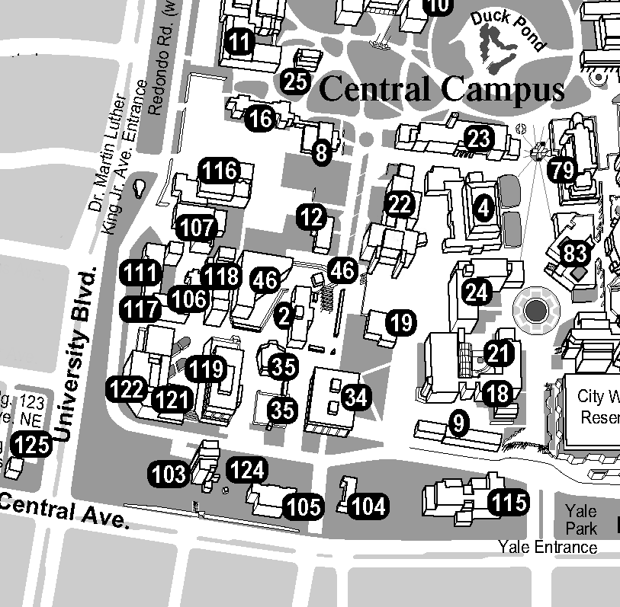
CONTACT INFORMATION
Mass Spectrometry Facility
Dr. Charlotte Mobarak
cmobarak@salud.unm.edu
(505) 277-8845 office, (505) 277-1665 lab
Ken Sherrell
sherrell@unm.edu
(505) 277-5329
NMR Facility
Dr. Karen Ann Smith
karenann@unm.edu
(505)277-4031 office, (505)277-1651 lab
X-Ray Facility
Dr. Eileen Duesler
duesler@unm.edu
505.277.6649 office & lab
Fax
(505)277.2609
GENERAL INFORMATION
The Analytical Chemistry Service facilities at the University of New Mexico are located in the Department of Chemistry and Chemical Biology.
The facilities are equipped with modern, state-of-the art equipment. Facilities staff offer support for investigators wishing to analyze compounds ranging from organic small molecules to materials to large proteins. The capabilities, instrumentation and rates are summarized in the enclosed table. Investigative and collaborative projects welcomed.
The Analytical Chemistry Service facilities
are the only place in the State of New Mexico where investigators can access such advanced instrumentation capabilities.
The University of New Mexico
Analytical Chemistry Service Facilities
NMR
X-RAY DIFFRACTION
MASS SPECTROMETRY
HOW TO FIND US
Physical location: Clark Hall
PERSONNEL
Karen Ann Smith, Group Leader and NMR Director
Eileen Duesler, X-Ray Director
Charlotte Mobarak, Mass Spectrometry Director
Kenneth Sherrell, Small Molecules Technician
Fall 2010
http://nmr.unm.edu
http://chemxray.unm.edu
http://massspec.unm.edu

Slide 2
Analytical Chemistry Service Facilities*
NMR
X-Ray Diffraction
Mass Spectrometry
The Nuclear Magnetic Resonance (NMR) Facility contains 3 spectrometers:
Bruker Avance 500: primarily a liquids NMR, with variable temperature, three RF channels, 3 axis gradients, and 3 solution probes. They are: 5 mm inverse broadband ; 5 mm inverse triple (proton, phosphorus, broadband); and 2.5 mm inverse broadband. All have a frequency range of ³¹P to ¹⁰⁹Ag, with VT and gradients. A CPMASS probe is also available.
Bruker Avance 300 widebore: primarily a solids NMR, with variable temperature, three RF channels, single axis gradients, and 8 probes. The probes are: 7 mm CPMASS; 4 mm CPMASS (both are ¹H and ³¹P to ¹⁰⁹Ag); 2.5mm CPMASS (triple tuned for fluorine, proton, and ³¹P to ¹⁵N); 7 mm CRAMPS (!H or ¹⁹F); 7 mm triple resonance (¹H, variety of X combinations); wideline probe with both 5 and 10 mm inserts; DOR (wide range); and 5mm proton/broadband liquids (¹⁵N to ³¹P) with gradients.
Bruker Avance 300 standard bore: liquids only NMR, with variable temperature, 2 RF channels, single axis gradients, auto-tune and match, and 2 probes. They are: 5 mm proton/broadband (³¹P to ¹⁵N) and a 10 mm proton/broadband (³¹P to ¹⁰⁹Ag).
Researchers needing NMR analysis are trained to obtain and interpret data on their own samples. In exceptional circumstances, facility personnel will obtain data for an additional fee. The facility is open for trained users 24/7, although non-UNM users must start and stop experiments during normal business hours. Current prices and status are given on the facility website nmr.unm.edu.
The X-ray laboratory has one diffractometer, the Kappa Apex II, Bruker’s top-of-the-line sealed tube chemical crystallography system. It combines the best 4-circle Kappa goniometer available with the APEX II- the most sensitive and fastest CCD detector. Because of the low dark noise and high gain due to lower CCD chip cooling, the instrument can handle a wide range of samples, from strongly diffracting to weakly diffracting. The system comes with a Molybdenum fine focus sealed tube, graphite monochromator and low temperature attachment for collecting data as low as -70C. We can determine structures of 5000 unique atoms or less. The facility offers data collection service with or without structure determination and also instruction on the use of the diffractometer to the university research groups.
See our website for current information.
chemxray.unm.edu
The Mass Spectrometry and Proteomics Facility (MSF) provides and maintains instrumentation for proteomics, functional protein analysis and the mass spectrometry needs of UNM investigators (and others). We provide full service sample processing on a fee basis including mass spectral analysis, protein identification and data analysis. The facility offers a variety of services including: 1) consulting services related to protein identification and characterization, 2) protein identification by PMF and MS/MS, 3) protein identification by de novo peptide sequencing, 4) phosphorylation site and other post translational modification characterization, recombinant protein characterization by mass spectrometry and 5) small molecule exact mass analysis. Please visit the web page, massspec.unm.edu, for a current listing of services offered and rates.
Current instrumentation includes:
4700 Proteomics Analyzer
Manufacturer: Applied Biosystems, Framingham, MA Mass range: m/z 200,000 for MS, m/z ~2,000 for MS/MS
Ionization (±eV): MALDI
Inlet Systems: LCPackings Ultimate 2D LC with Probot spotting robot
Uses: Proteomics, peptide sequencing, MS/MS
Water/Micromass LCT Premier
Manufacturer: Waters/Micromass, Manchester, U.K. Mass range: m/z 12,000+
Ionization (±eV): Electrospray (z-spray, lockspray), Atmospheric pressure chemical ionization (APCI) and Atmospheric pressure photoionization (APPI)
Inlet Systems: HP Series 1100 HPLC
Uses: Exact mass determinations, protein mass measurement
special sample analyses and larger collaborative research are also available upon consultation with the individual facility directors

